Slide 1
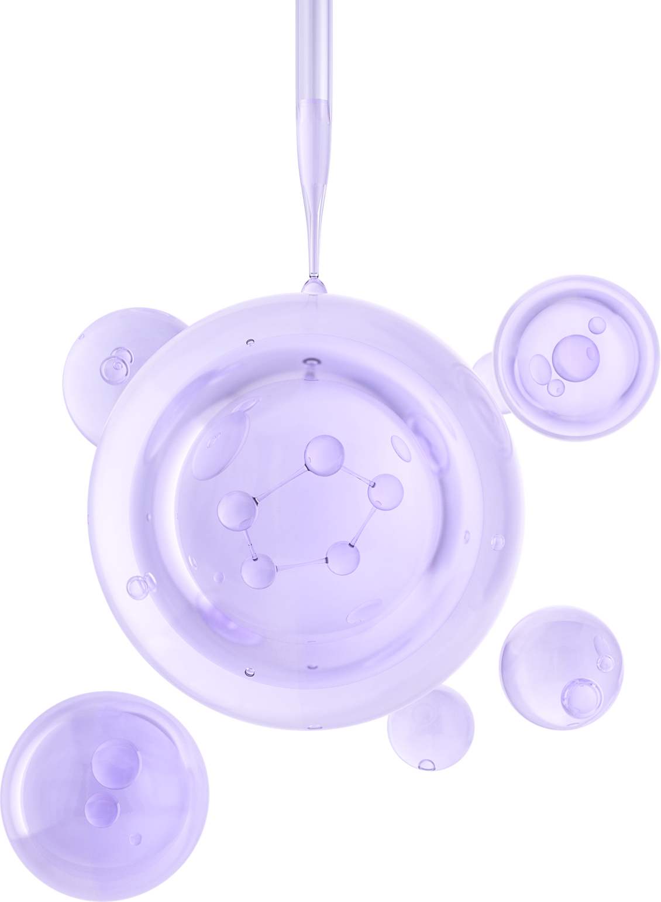

UNIVERSITY OF BASRAH / COLLEGE OF SCIENCE
LECTURE PhD 5
Work of Enzymes
Department of Biology
Prof.Dr. Saad S. Mahdi Al-Amara

Slide 2
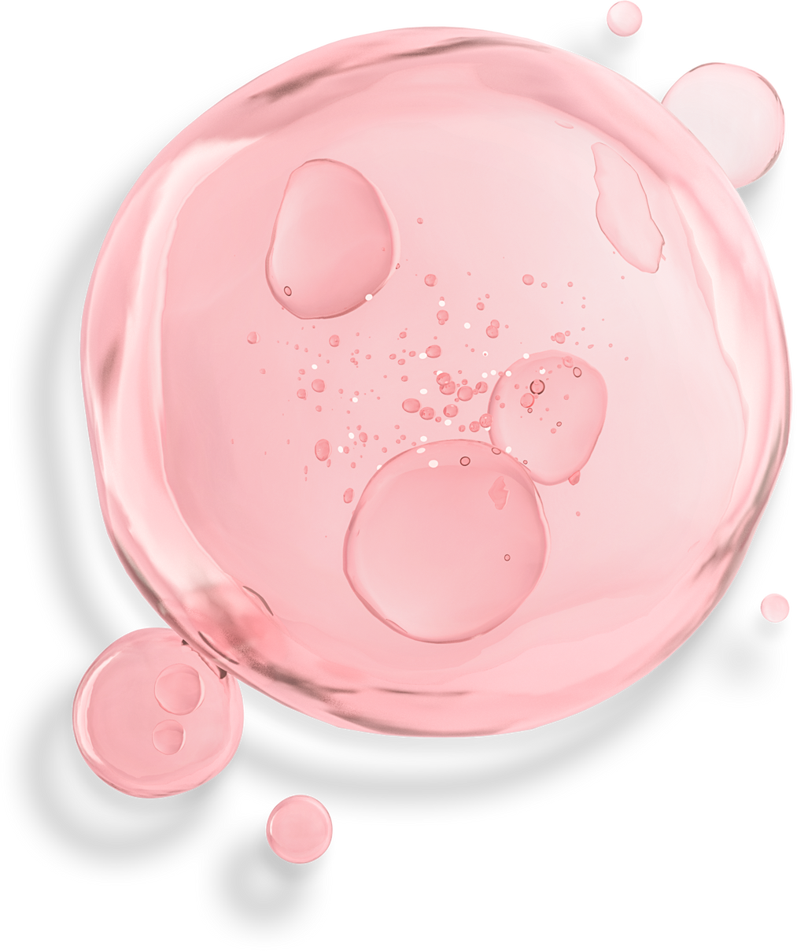
Cofactors: Supporting the Work of Enzymes
You learned that microorganisms require specific metal ions called trace elements and certain organic growth factors. In many cases, the need for these substances arises from their roles as cofactors for enzymes.
The metallic cofactors, including iron, copper, magnesium, manganese, zinc, cobalt, selenium, and many others, participate in precise functions between the enzyme
and its substrate.
In general, metals activate enzymes , help bring the active site and substrate close together, and participate directly in chemical reactions with the enzymesubstrate complex.
Coenzymes are a type of cofactor. They are organic compounds that work in conjunction with an apoenzyme to perform a necessary alteration of a substrate.
The general function of a coenzyme is to remove a chemical group from one substrate molecule and add it to another substrate, thereby serving as a transient carrier of this
group.

Slide 3
Classification of Enzyme Functions
Enzymes are classified and named according to characteristics such as site of action, type of action, and substrate , Most metabolic reactions require separate and unique enzymes.
A standardized system of nomenclature and classification , in general, an enzyme name is composed of two parts: a prefix or stem word derived from a certain characteristic , usually the substrate acted upon or the type of reaction catalyzed, or both , followed by the ending -ase.
The system classifies the enzyme in one of these six classes,on the basis of its general biochemical action:
Oxidoreductases transfer electrons from one substrate to another, and dehydrogenases transfer a hydrogen from one compound to another.
2. Transferases transfer functional groups from one substrate to another.
3. Hydrolases cleave bonds on molecules with the addition of water.
4. Lyases add groups to or remove groups from double-bonded substrates.

Slide 4
5. Isomerases change a substrate into its isomeric form.
6. Ligases catalyze the formation of bonds with the input of ATP and the removal of water.
Each enzyme is also assigned a common name that indicates the specific reaction it catalyses. With this system, an enzyme that digests a carbohydrate substrate is a carbohydrase; a specificcarbohydrase, amylase, acts on starch (amylose is a major component of starch).
The enzyme maltase digests the sugar maltose. An enzyme that hydrolyzes peptide bonds of a protein is a proteinase, protease, or peptidase, depending on the size of the protein substrate.
Some fats and other lipids are digested by lipases.
DNA is hydrolyzed by deoxyribonuclease, generally shortened to DNase.A synthetase or polymerase bonds together many small molecules into large molecules.
Other examples of enzymes are presented in table 2.1.

Slide 5
Table 2.1 A Sampling of Enzymes , their Substrates and Their Reaction
Lactase | β-D-galactosidase | Hydrolase | Lactose | Breaks lactose down into glucose and galactose
Penicillinase | Beta-lactamase | Hydrolase | Penicillin | Hydrolyzes beta-lactam ring
DNA polymerase | DNA nucleotidyl transferase | Transferase | DNA nucleosides | Synthesizes a strand of DNA using the complementary strand as a model
Lactate dehydrogenase | Same as common name | Oxidoreductase | Pyruvic acid | Catalyzes the conversion of pyruvic acid to lactic acid
Oxidase | Cytochrome oxidase | Oxidoreductase | Molecular oxygen | Catalyzes the reduction of O2 (addition of electrons and hydrogen)

Slide 6
Location and Regularity of Enzyme Action
Enzymes perform their tasks either inside or outside of the cell in which they were produced.
Endoenzymes are retained intracellularly and function there.
Exoenzymes are transported extracellularly ,where they break down (hydrolyze) large food molecules or harmful chemicals. Examples of exoenzymes are cellulase, amylase, and penicillinase. (figure 2.5).
The enzymes are not all produced in equal amounts or at equal rates. Some, called
constitutive enzymes (figure 2.6a), are always present and in relatively constant amounts, regardless of the amount of substrate.
The enzymes involved in utilizing glucose, for example, are very important in metabolism and thus are constitutive .
Other enzymes are regulated enzymes (figure 2.6b), the production of which is either turned on (induced) or turned off (repressed) in response to changes in concentration of the substrate.

Slide 7
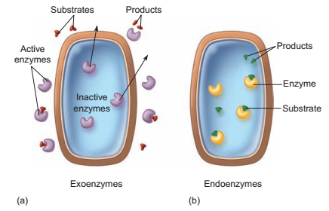
Figure 2.5 Types of enzymes, as described by their location of action. (a) Exoenzymes are released outside the cell to function. (b) Endoenzymes remain in the cell and function there.

Slide 8
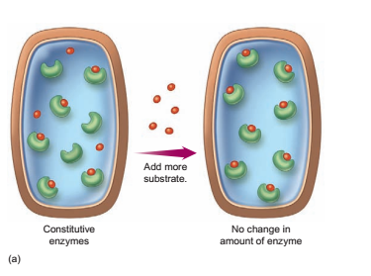
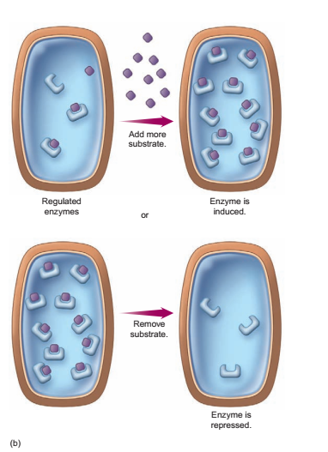
Figure 8.6 Constitutive and regulated enzymes.
(a) Constitutive enzymes are present in constant amounts in a cell . The addition of more substrate does not increase the numbers of
these enzymes.
(b) The concentration of regulated enzymes in a cell increases or decreases in response to substrate levels.

Slide 9
Synthesis and Hydrolysis Reactions
A growing cell is in a frenzy of activity, constantly synthesizing proteins, DNA, and RNA; forming storage polymers such as starch and glycogen; and assembling new cell parts.
Such anabolic reactions require enzymes (ligases) to form covalent bonds between
smaller substrate molecules.
Also known as dehydration reactions, synthesis reactions typically require ATP and release
one water molecule for each bond made (figure 2.7a).
Catabolic reactions involving energy transactions, remodeling of cell structure, and digestion of macromolecules are also very active during cell growth. For example, digestion requires enzymes to break down substrates into smaller molecules so they can be used by the cell.
Because the breaking of bonds requires the input of water, digestion is often termed a
hydrolysis reaction (figure 2.7b).

Slide 10
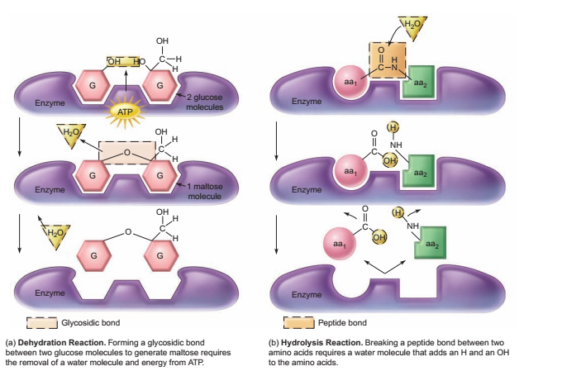
Figure 2.7 Examples of enzyme-catalyzed synthesis and hydrolysis reactions.

Slide 11
THANK YOU

